Slide 1

Myntra Brand and Market Analysis
An In-depth Analysis of Online Brand Perception and Customer Sentiment
Rajmurthi KM | MBE11

Slide 2
Introduction
Overview of Myntra:
Myntra is one of India’s leading online fashion and lifestyle retailers, known for its extensive range of clothing, accessories, and footwear.
Operates on a marketplace model, partnering with various brands to offer a wide selection of products.
Objectives:
Assess Brand Perception: Understand how consumers view Myntra through social media and reviews.
Identify Emerging Fashion Trends: Utilize data to pinpoint current and upcoming trends in the fashion industry.
Evaluate Competitive Standing: Analyze Myntra’s position relative to its competitors.
Provide Actionable Recommendations: Suggest strategies to enhance Myntra's market position based on findings.

Slide 3
SWOT Analysis
Strengths
Strong Brand Recognition: Myntra is a household name in the Indian online retail space, synonymous with fashion.
Wide Product Range: Offers a diverse selection of products, catering to different styles and budgets, which attracts a broad customer base.
Exclusive Partnerships: Collaborations with popular brands and designers provide unique offerings that differentiate Myntra from competitors.
Weaknesses
Customer Service Issues: Negative feedback about slow response times and challenges with the returns process can affect customer loyalty.
Delivery Delays: Issues with logistics have led to complaints about delayed deliveries, impacting overall customer satisfaction.

Slide 4
SWOT Analysis
Opportunities
Growing Market for E-commerce: Increased internet penetration and smartphone usage create a larger customer base for online shopping.
Sustainable Fashion Trend: Consumers are becoming more environmentally conscious, presenting an opportunity to launch eco-friendly products.
Influencer Collaborations: Engaging with social media influencers can enhance brand visibility and attract younger audiences.
Threats
Intense Competition: Competitors like Amazon Fashion and Flipkart present significant challenges, often offering competitive pricing and faster shipping.
Economic Downturns: Changes in economic conditions can affect consumer spending patterns and overall sales.
Changing Consumer Preferences: Rapid shifts in fashion trends and customer expectations require constant adaptation.

Slide 5

Data Collection
Platforms Used:
Social Media: Analyzed posts and discussions on platforms such as Twitter, Instagram, and Facebook to gauge public sentiment.
Customer Reviews: Collected data from Google Reviews, Trustpilot, and Myntra's own product pages to understand customer feedback.
Methodology:
Employed relevant hashtags (e.g., #Myntra, #Fashion) to gather data related to customer experiences and opinions.
The data collection was conducted over a 6-month period (April 2024 – September 2024) to capture recent trends and sentiments.

Slide 6

Data Visualization
Tools Used: Power BI is utilized for data analysis and visualization.
Key Dashboards Created:
Sentiment Analysis Dashboard: Visualizes the proportion of positive, negative, and neutral sentiments related to Myntra.
Brand Perception Chart: Displays key descriptors associated with the brand based on customer feedback.
Trend Analysis Graphs: Showcases emerging fashion trends and popular styles derived from social media discussions.

Slide 7
Brand Perception Analysis
Positive Aspects:
Many customers highlight Myntra's extensive selection of fashionable clothing and accessories, making it a go-to destination for fashion.
Regular sales events and exclusive offers are well-received, enhancing customer satisfaction.
Negative Aspects:
Significant feedback regarding delayed deliveries and inconsistent customer service has been noted, which can tarnish the overall brand image.
Challenges with the returns process were also common in customer reviews, indicating a need for improvement.

Slide 8
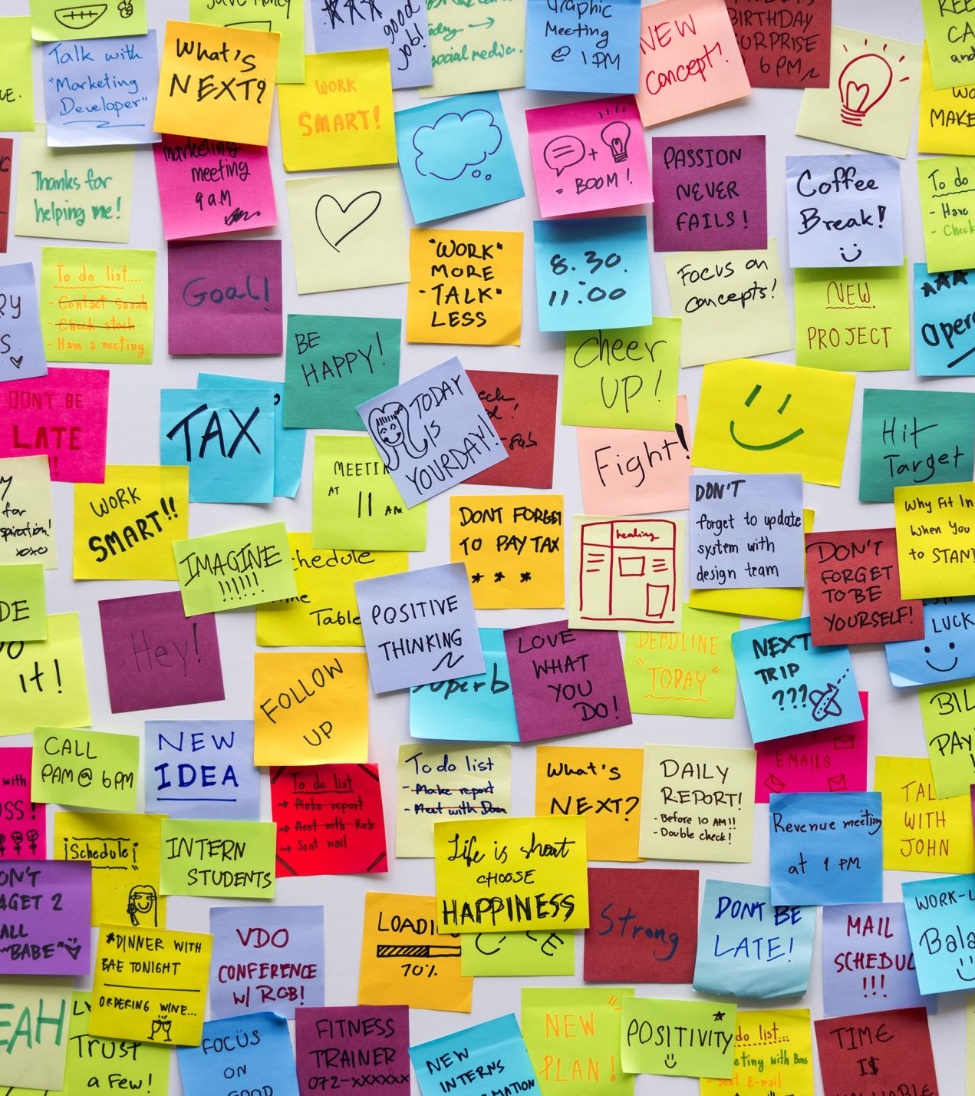
Customer Sentiment Analysis
Sentiment Breakdown:
Positive Sentiment (60%): Customers praise the variety of products and competitive pricing.
Neutral Sentiment (15%): General discussions without strong opinions.
Negative Sentiment (25%): Complaints primarily focused on delivery and service issues.
Key Drivers of Sentiment:
Positive sentiment is largely driven by product quality and variety, while negative sentiment relates to logistical inefficiencies and customer service experiences.

Slide 9

Market Trend Analysis
Emerging Trends:
Sustainable Fashion: There is a growing interest in eco-friendly and sustainable products among consumers.
Athleisure Wear: The trend towards comfortable, casual clothing that can be worn for multiple occasions is on the rise.
Ethnic and Festive Wear: Increased interest in traditional styles during festive seasons, which can be leveraged for targeted marketing.
Influencer Impact:
Influencers play a crucial role in shaping consumer opinions and driving discussions about Myntra’s offerings, particularly among younger demographics.

Slide 10
Competitive Landscape Assessment
Competitors:
Amazon Fashion: Known for quick delivery and a vast product range, presenting a strong competitive threat.
Flipkart Fashion: Focuses on budget-friendly options, appealing to price-sensitive consumers.
AJIO: Strong in the premium fashion segment, attracting customers looking for unique styles.
Comparative Analysis:
Myntra excels in exclusive partnerships with designers and brands but needs to address its customer service and logistics to compete effectively.

Slide 11

Strategic Recommendations
Enhance Delivery and Customer Service:
Improve logistics partnerships and implement better communication channels to address customer inquiries promptly.
Introduce Sustainable Fashion Line:
Launch a collection of eco-friendly products to attract environmentally conscious consumers.
Strengthen Influencer Marketing Efforts:
Collaborate with more influencers to enhance brand visibility and engage with a younger audience effectively.
Focus on Competitive Differentiation:
Highlight exclusive designer collaborations in marketing efforts to distinguish Myntra from competitors.

Slide 12

Project Evaluation Metrics, Technical Tags
Metrics for Success:
Quality of data collection and analysis.
Depth of insights into customer sentiment and brand perception.
Clarity and practicality of strategic recommendations.
Overall quality of the final report and presentation materials.
Relevant Tags:
Social Media Analysis
Sentiment Analysis
E-commerce
Fashion Trends
Competitor Analysis
Data Visualization

Slide 13
Project Timeline
21–23 Sep.
(Saturday-Monday): Data collection and initial analysis.
Focus on gathering social media posts and customer reviews.
24 Sep.
(Tuesday): Conduct sentiment and brand perception analysis.
Analyze the data collected to categorize sentiments.
25–26 Sep.
(Wednesday-Thursday): Perform competitive analysis and develop final recommendations.
Compare Myntra’s performance against key competitors and formulate strategies.
27–29 Sep.
(Friday-Sunday): Write the report and prepare the presentation.
Draft the final report and design presentation materials.
30 Sep.
(Monday): Final review and submission of the project.
Ensure all elements are polished and ready for presentation.

Slide 14
Conclusion
Summary:
Myntra is well-regarded for its product variety and brand recognition, but it faces challenges in logistics and customer service.
Future Recommendations:
Focus on improving customer experience, enhancing operational efficiency, and leveraging emerging trends to maintain and grow market position.

